Slide 1
Doctor Channeling Management System
Group 01
IT & Computing School-Class of 2025A

Slide 2

Group Members
Pasindu Jayathunga – 21UG0068
Siwaneththi Dilushi Pabasara – 21UG0264
D.M.D.Nayanamini – 21UG0778
Manujaya Vimukthi – 21UG0234
G.B.S.Mashenka – 21UG0890
N.K.Rajapaksha – 21UG0773
Malkini Wijesekara – 21UG0160
Thumula Basura Suraweera – 21UG0016
Upeka Sathsarani – 21UG0127
Maleesha Thisaranga – 21UG0113

Slide 3
Table of Contents
Responsibilities as a BA member
Key tasks in SDLC(Software Development Life Cycle)
Software development methodology justification
Requirement gathering techniques
Functional and non-functional requirements
Use Case Diagram
Recommendations
Risk Recognition

Slide 4
Responsibilities as a BA member
Gathering information on the project through research
Understanding the key objectives
Deliver project responsibilities with deadlines
Staying updated about document progress, set backs and new processes
Communicating with project leads on roadblocks

Slide 5
Key tasks which will be carried out in each stage of SDLC
and the importance of each.
Initiation
Requirements
Design
Development/implementation
Testing
Deployment
Maintenance

Slide 6
The software development methodology will be more
appropriate to be used.
- Agile development methodology

Slide 7
Three requirement gathering techniques which will be more
appropriate for the given system and
how each technique will be implemented.
One-on-One Interviews
Questionnaires/Surveys
User Observation

Slide 8
A list of the functional and non-functional requirements and
more on the selected nonfunctional requirements
particular to the given system.
Functional Requirements:
Non- functional requirements:

Slide 9
Use case diagram to the given system
In this management system patient’s info is being recorded.
And it’s been maintained in a database.
Available Appointments, Scheduled Appointments and Selected ones are store in appointments database.
Patient info with appointments, updated patient info & newly patient info stored in patients database.
Prepare reports get data from patients database and appointments database & it provides appointment and patient report for Doctor.
Billing and patient connected through appointments database.
Perform billing provides patient payment info to billing and, billing will return payment confirmation after the payment completely done.
Payment info & patient bill info done through perform billing.

Slide 10
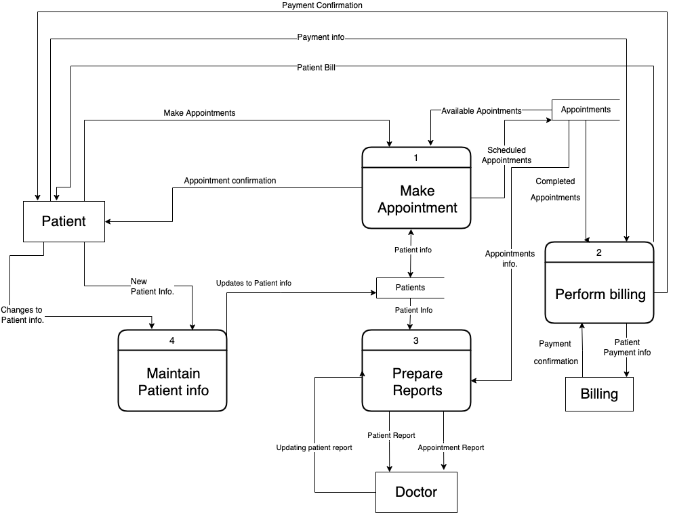

Slide 11
Develop recommendations to improve the project initiation phase
and requirement elicitation process and
how that will improve the life cycle of the project.
Initiation Phase
Requirement Elicitation Process

Slide 12
Risks associated with the project

Slide 13
Q & A?

Slide 14
THANK YOU!

